Slide 1


WATER SCARCITY IN REMOTE COMMUNITIES
Novia C. Joshua C. Minh H. Joshua S. Marko S. William W. Yon Z.
Notes:
Hello guys! Hi minh

Slide 2
TABLE OF CONTENTS
1
Introduction
6
Decision-making Process
Solutions Considered
Physical Prototyping
Virtual Prototyping
Design Decisions
Risk
Sustainability/Suitability
2
Project Context
3
Design Recommendation
7
Design Justification
4
Stakeholders + Needs
8
Conclusion
5
Key Assumptions
9
Appendix

Slide 3




PROJECT CONTEXT
Developing a Rain Water Harvesting (RWH) system to provide adequate clean water to satisfy a pilot household of two people.
This RWH system will:
Capture water
Filter/Purify
Store excess
Supply back to user
Notes:
http://simpleicon.com

Slide 4
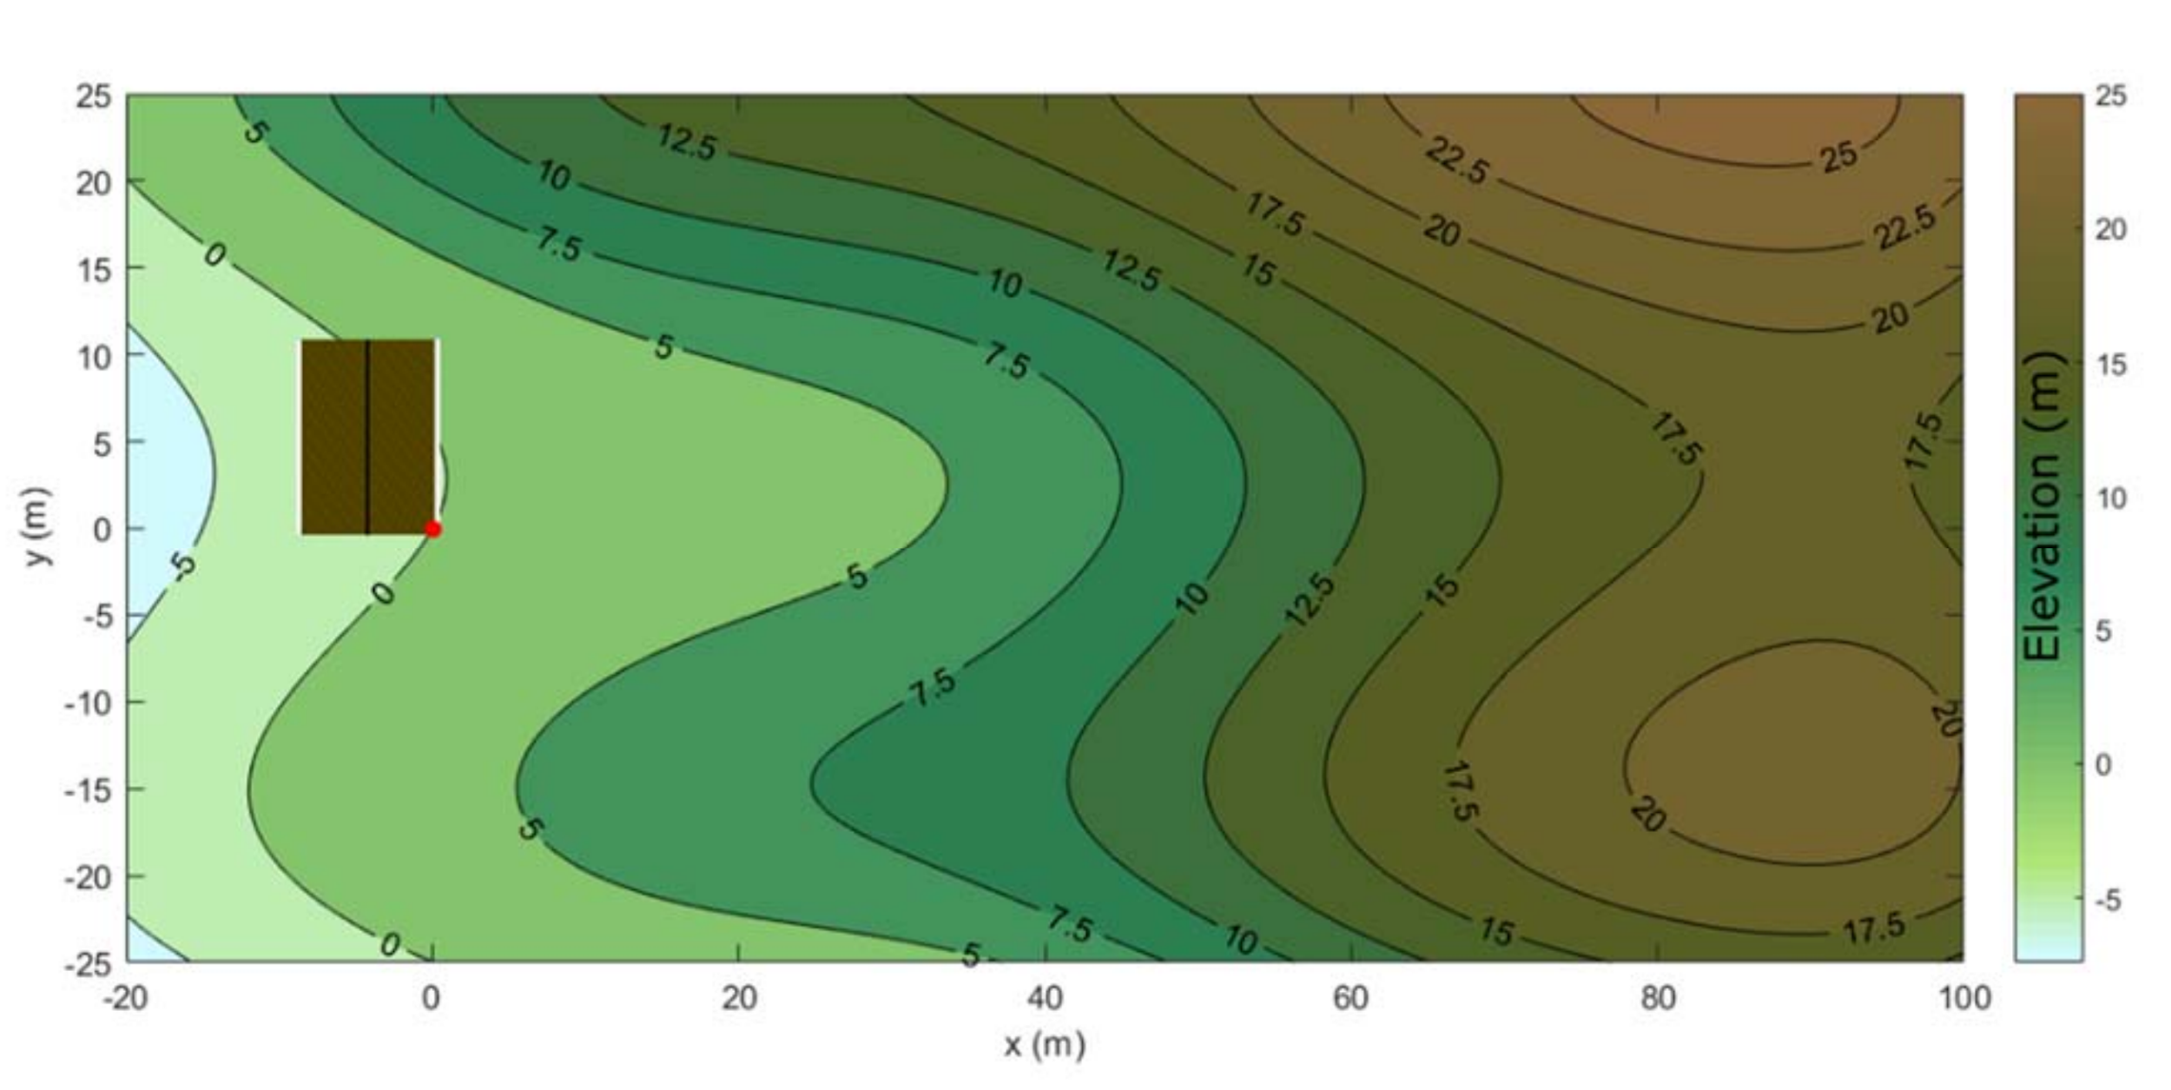
DESIGN RECOMMENDATION
Comprised of the following components:
Two solar panels
Three filters (1μm, 5μm, and 200μm)
Chlorine treatment system
50 watt UV system
Pump
Storage to house filter location
Ground-level Storage tank
Catchment tank
Storage Tank

Slide 5


STAKEHOLDERS
NEEDS
Members of RES’EAU WaterNET
Remote communities
of coastal British Columbia
Equipment Manufacturers
R2 Design Team
Health Authorities
Consultants
Independent power system
Sustainable
Sufficient clean water
Resilient system
Cost-efficient
Simple, easily maintained
Compliant with regulations
Notes:
William Independent power system = does not rely on electrical power filtration

Slide 6
KEY ASSUMPTIONS
Gravitational acceleration: 9.81 m/s²
Density of water = 1000 kg/m³
Constants
Pipe Diameter: 20 mm
Pipe friction factor (f ) = 0.05
Restriction Loss Coefficient (K )= 10
Little rain deviation from rain harvesting data
Model assumption
Pipe length => distance between home and storage tank
Measured values
C_{f} = 8628.245

Slide 7
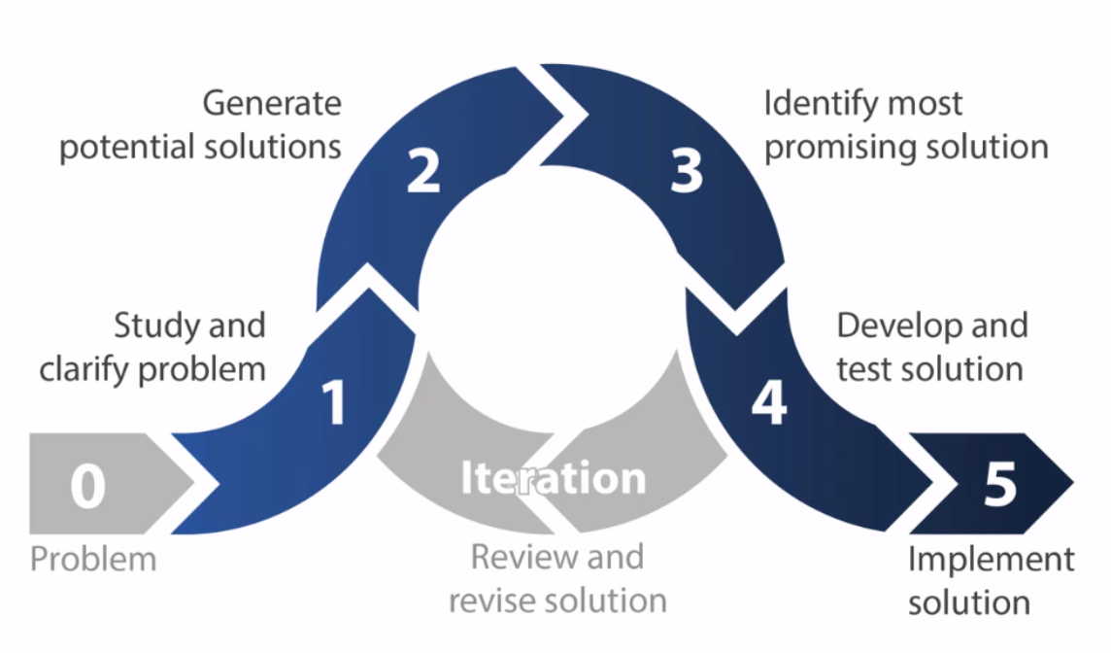
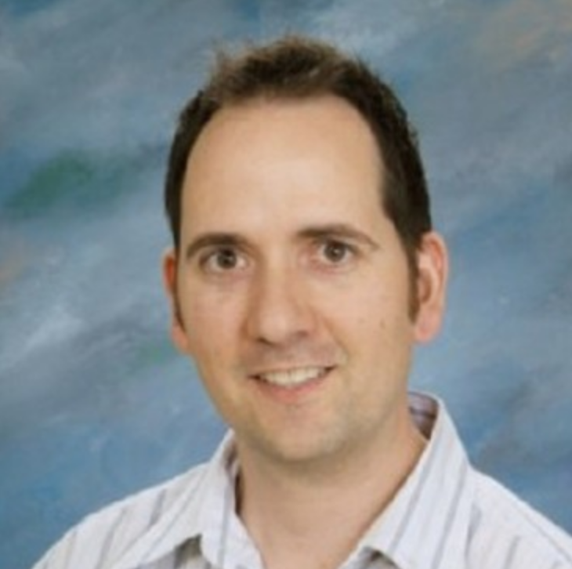
DECISION MAKING PROCESS
Analyzing main components in our design solution
Rainwater collection
Storage
Pump
Filtration
Disinfection
Power System
Prototyping:
(physical and virtual)
Analyzing risk

Slide 8
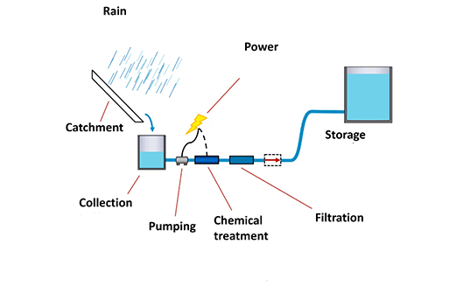
SOLUTIONS CONSIDERED
Seasonal variation & Amount
Ground Level vs Elevated
Solar vs. Diesel
50W vs. 36W UV System
Size & additional Catchment
Filter Line Location
1μm,5μm, 200μm
Types of Pumps
vs. Ozone Treatment
Notes:
Here are a few of the solutions that we have considered through our rain water harvesting system. Elements include using solar as a power system instead of disel and we looked at various cases of the capacity, cost and maintenance overall being effects.
Types and differences amongst the 1,5 and 200 um filter amongst cost, maitenance weighing each of their pros and cons.
Considered a disinfection system but, overall decided to go with chlorine over Ozone as it was weighted more heavily towards the satisfaction of stakeholders in our model.
And we also considered other elements like types of pumps, location of filters, qualities and specifications of both our storage tank and catchment tank for maximizing proficciency in unpredictable weather conditions.

Slide 9
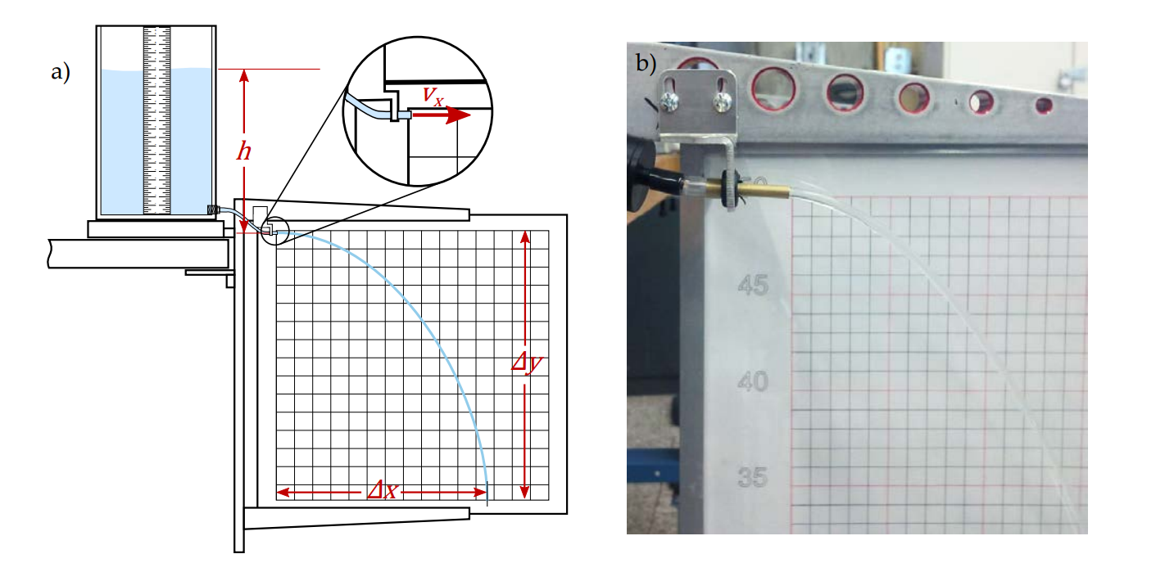
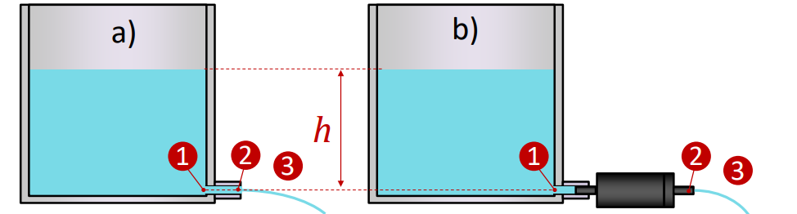
PHYSICAL PROTOTYPING
Using prototypes of RWH components to:
Calculate C_{f}, K, f
Observe flow rate behaviour through varying lengths of tubes

Slide 10
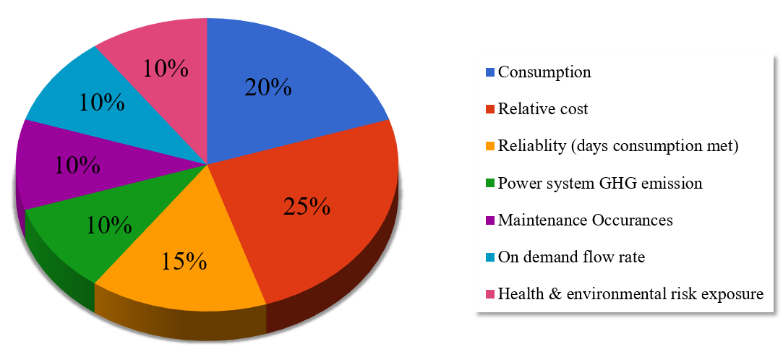
COMPREHENSIVE VIRTUAL PROTOTYPING
Optimizing Satisfaction for Satisfaction Criteria
Notes:
To account for all the factors which all affect each other and play a role in our decision, we constructed a comprehensive virtual prototype in which we used real rainfall data to model our solution. We used this model to optimize different parameters in our design and used stakeholder satisfaction curves along with these weightings and our prototype to fine-tune our design parameters and arrive at the most optimal solution.

Slide 11
DESIGN DECISIONS
Overall Consumption:
530 L/day
Environmental Impact
Reliability
Cost
Maintenance
Solar Panels
Increasing Catchment Tank Size
Greatest number of filters for less maintenance
Maximize effectiveness over spending amount
We decided to be liberal with our spending usage and maximize our system effectiveness
Solar panels were chosen to minimize environmental impact
The lowest amount of filters was chosen to provide a low maintenance system
The flow rate was not a focus point, and was a result of the other factors in the system
The reliability was at an acceptable standard, as we prioritized the litres provided per day rather than the days serviced by the system
Notes:
Throughout this prototyping process, our decisions revolved around 5 main factors: Consumption, cost, environmental impact, reliability, and maintenance occurances. Of course there were some trade-offs between these decisions and since adjusting some parameters will affect many more, we tried to compromise best we could in the interest of stakeholder satisfaction. We determined a daily consumption value of 550L/day was optimal, used solar panels to decrease environmental impact, increased catchment tank size to ensure resiliency in our system and make sure it is reliable for more punishing rainfall patterns, and used the maximum amount of filters to minimize maintenance occurances.

Slide 12


RISK
Identified Risk:
Variations in future rainfall
Amount of GHG Emissions
Reducing Risk:
Larger storage tank
During times of low rainfall, the household can draw from the stored water reserves
Provides a safety net, ensuring that the household stays supplied with water even in periods of drought
Solar instead of Diesel
Risk Reduction

Slide 13



SUSTAINABILITY
Societal:
Economic:
Environmental:
- Provides clean water for the residents
- Lowers economic burden of shipping in water bottles, allowing residents to spend money on themselves and have a higher standard of living
- Gives back economic agency to Van Anda
- Removes cost of shipping in water bottles
- Simple maintenance and low costs for effectiveness in perpetuity
- Solar powered, low GHG emissions
- Reusable system, low landfill production
Notes:
Images from http://simpleicon.com

Slide 14
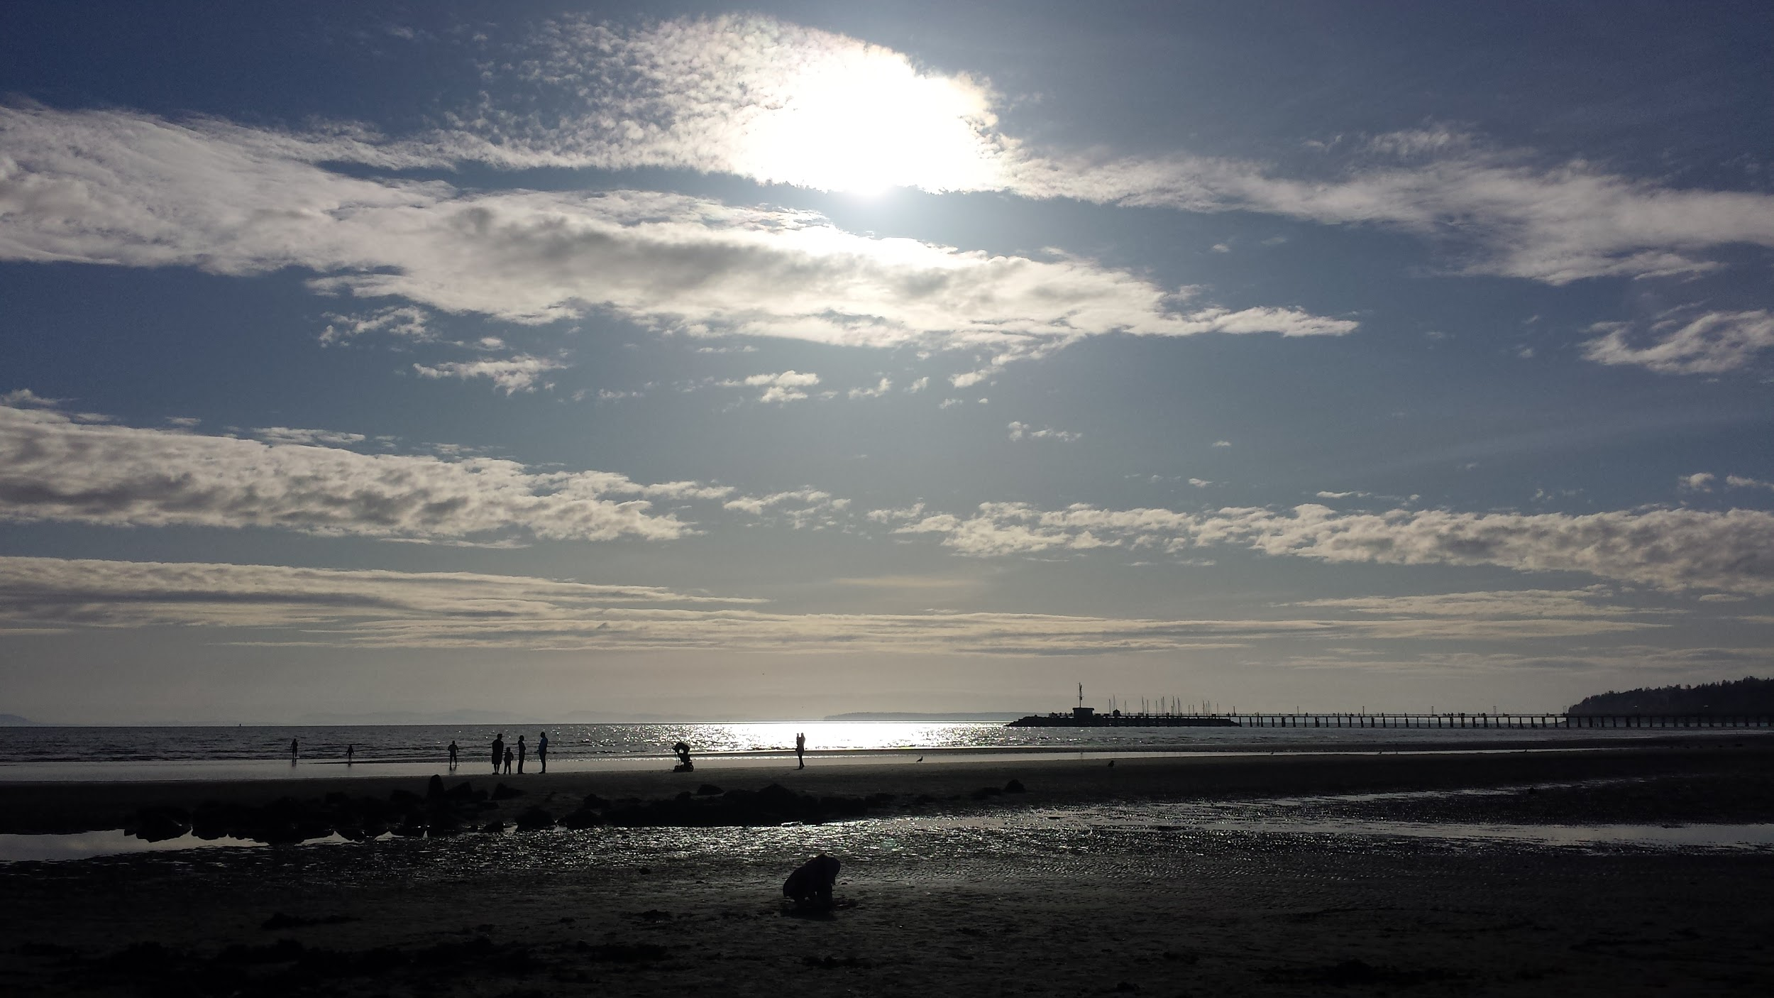
DESIGN JUSTIFICATION
Optimal solution for the project context
Tested with real weather data
Takes into account interloping factors and risks/tradeoffs
Achieves high degree of stakeholder satisfaction

Slide 15


CONCLUSION
Environmentally Conscious
Impeccable Reliability
Minimal Maintenance
Optimized Costs
Notes:
Suitable to small community context
House icon https://www.iconfinder.com/icons/872756/happy_family_happy_home_heart_sign_house_love_home_icon#size=128
Raincloud icon

Slide 16
84.7%
Overall Satisfaction

Slide 17
APPENDIX
Upper and Lower Water Limits
Physical Prototyping
Physical Prototyping Results (2)
Virtual prototyping (2)
Pump vs. System Analysis
Preliminary Storage Tank Model
Final Satisfactions
Satisfaction Curves (2)
Health and Environmental Risk

Slide 18
Lower Justification
Upper Justification
Estimate for total litres/day:
122.0
Key Assumptions (per person):
Washroom: once a day
Showering once a week
Wash dishes 2 times a week
Drinking 946.353mL of water a day
No other indoor uses
They would be satisfied. We took minimum usage as the definition for the lowest amount used for the two people. This would result in a high satisfaction level as they would be efficient, conservant and sustainable.
Estimate for total litres/day:
478.4
Key Assumptions (per person):
Washroom seven times a day
Drinking 1892.71ml of water
Two showers per day
Indoor uses of water occur, including watering potted plants, feeding pets, etc.
They would be satisfied. We took a very high maximum amount for usage. Some of these assumptions are unreasonable to expect a single person to use, which means that it would go above and beyond their usage.
Appendix A: Upper and Lower Water Limits

Slide 19
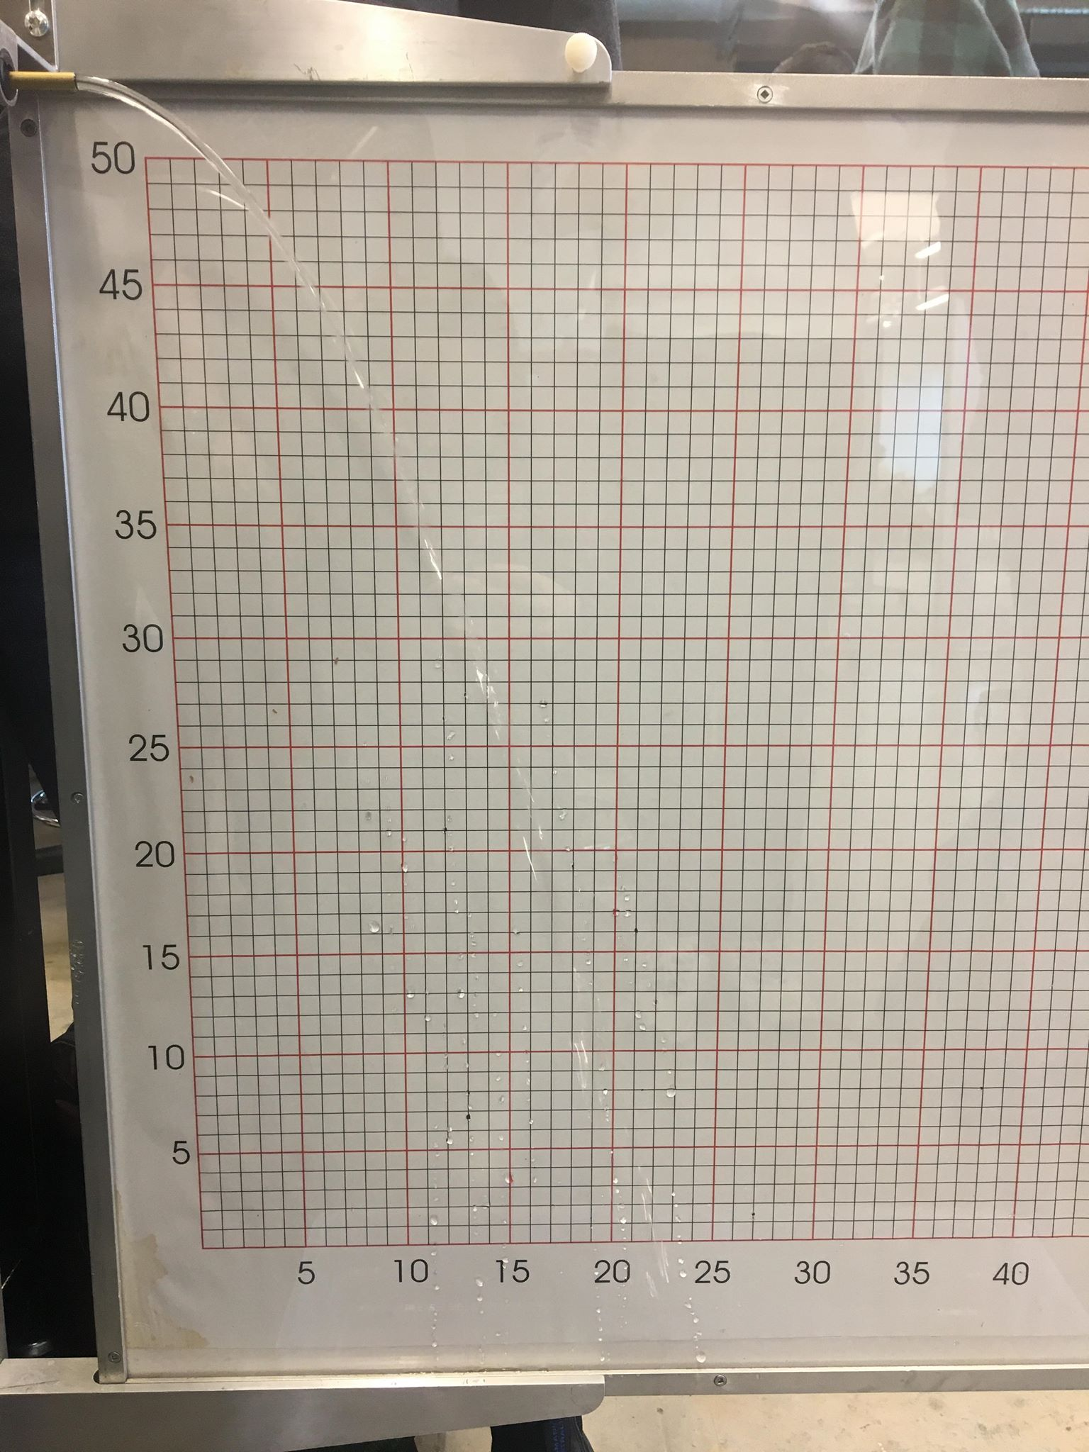
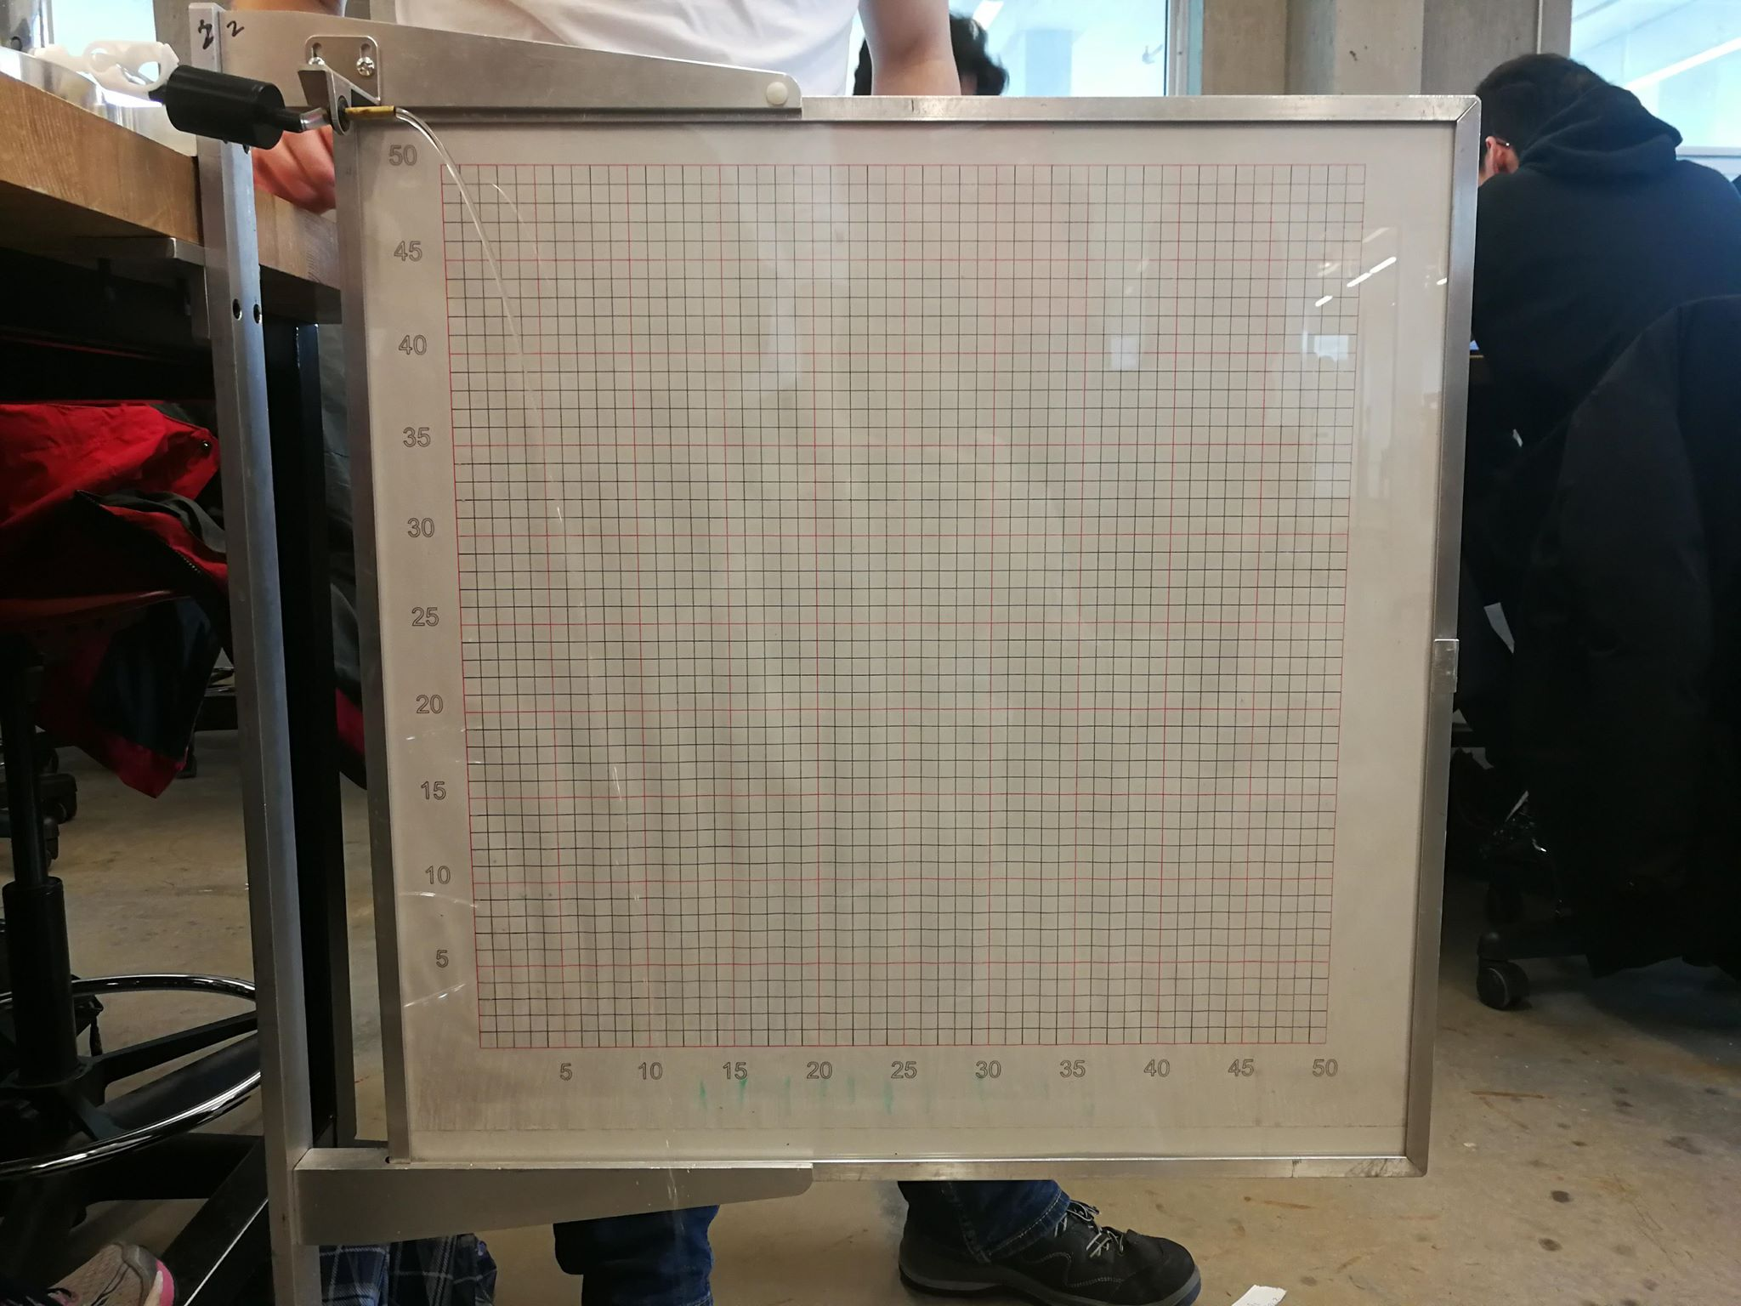
Appendix B: Physical Prototyping

Slide 20
Appendix C: Physical Prototyping Results (1)
Lab A
Experiment | pgh | (1/2)pv^2 | p (losses) | f | K | Cf
Base Case | 2383.83 | 463.52 | 667.08 |  | 1.44
 | 1716.75 | 406.53 |  |  | 1.64
 |  |  |  |  | 1.54
Piping Losses | 2187.63 | 119.59 | 431.64 | 0.01 | 1.54
 | 1755.99 | 78.95 |  | 0.01 | 1.54
Clean Filter | 2491.74 | 105.11 | 735.75 |  | 1.54 | 1251.67
 | 1755.99 | 46.71 |  |  | 1.54 | 2171.72
Fouled Filter | 2491.74 | 112.23 | 755.37 |  | 1.54 | 1229.55
 | 1736.37 | 78.95 |  |  | 1.54 | 1595.00

Slide 21
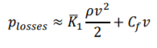
Appendix C: Physical Prototyping Results (2)
Base Case - Nozzle Only
Piping Losses - 1 Metre Tubing
Clean Filter
Fouled Filter
Friction and filter losses are negligible
H₁: K = 1.439
H₂: K = 1.641
K_{avg} = 1.54 (constant for all other experiments)
Filter Losses are negligible
H₁: f = 0.00985
H₂: f = 0.00985
Friction is negligible
H₁: C_{f} = 1229.553064
H₂: C_{f} =1595.002909
Friction is negligible
H₁: C_{f} = 1251.674272
H₂: C_{f} = 2171.7
Loss Coefficient Calculations: since losses due to friction is negligible for the clean and fouled filter cases, the formula for pressure losses is:
Hence, Filter loss coefficient C_{f} = (Pressure loss - Kρv^2/2)
H₁=When water tank is full
H₂=When water tank at 180mL
The trend we noticed is the flow rate decreases as the stock water decreases in quantity. In addition, as the length of tubing the water needs to flow through is increased, the flow rate is decreased.

Slide 22
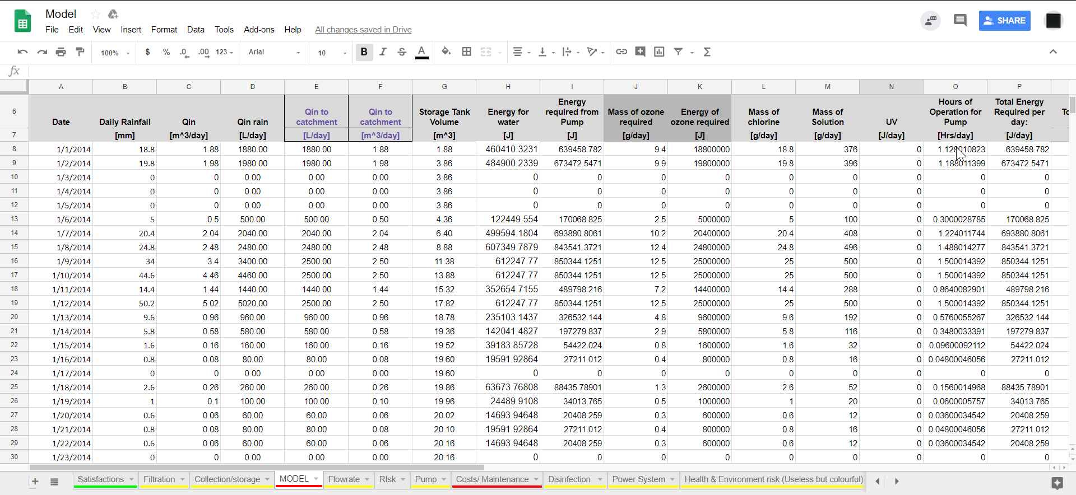
Appendix D: Virtual prototyping (1)

Slide 23
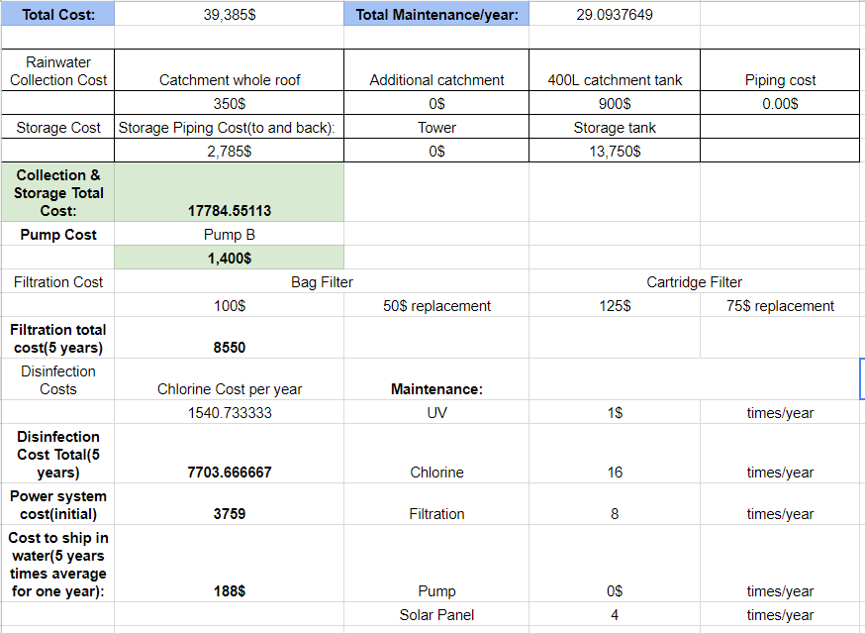
Appendix D: Virtual prototyping (2)

Slide 24
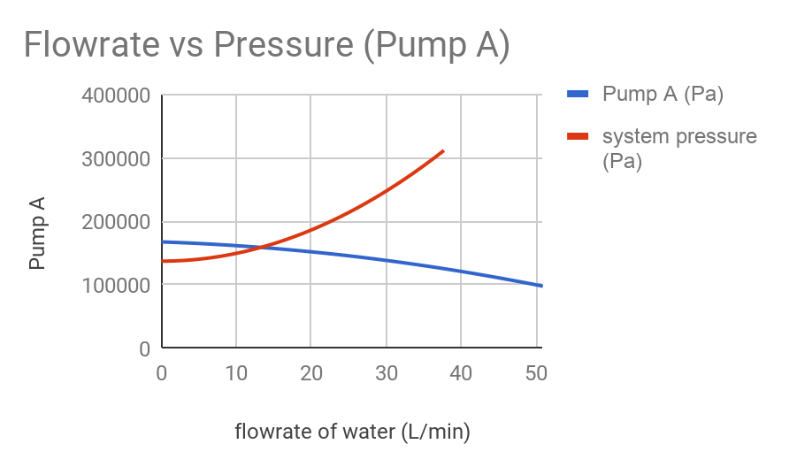
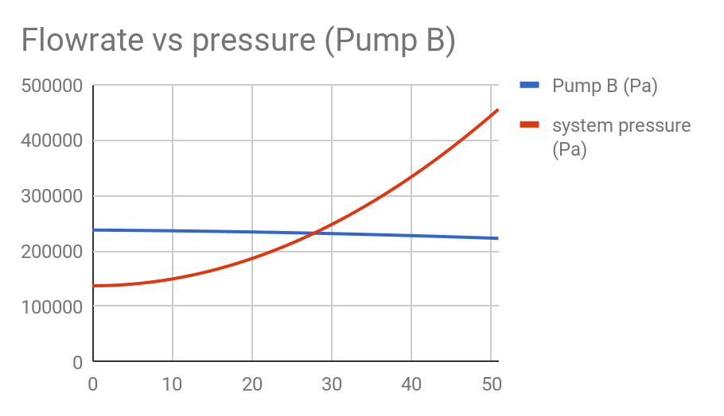
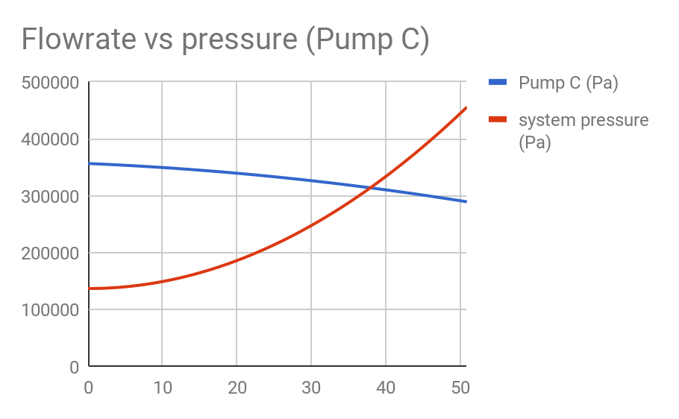
Appendix E: Pump vs. System Analysis
Pump A is eliminated due to low flow rate.
Pump C is eliminated due to high initial cost.
Pump B is chosen due to highest efficiency and reasonable flow rate (27.8 L/min) and cost.

Slide 25
Appendix F: Preliminary Storage Tank Model
Tank Volume Recommendations:
Analysis shows that there will always be a day that the tank volume in station 2 and station 3 goes to 0 (rainfall cannot compensate the water consumption) for 50% and 100% satisfactions.
 | Volume of tank for ~1% Satisfaction | Volume of tank for ~50% Satisfaction | Volume of tank for ~100% Satisfaction
Station 1 – 2014 | 5.861 [m³] | 16.624 [m³] | 44.02 [m³]
Station 1 – 2015 | 7.523 [m³] | 28.67 [m³] | 55.35 [m³]
Station 2 – 2015 | 8.342 [m³] | 0 [m³] | 0 [m³]
Station 3 – 2013 | 5.012 [m³] | 0 [m³] | 0 [m³]

Slide 26
Appendix G: Final Satisfactions
 | Raw values | Weight | Min | Max | Satisfaction
Consumption | 530.0 | 20% | 135 | 600 | 94.5%
Relative cost | 49.2 | 25% | 25 | 125 | 86.2%
Health & environmental risk exposure | 16.2 | 10% | 0 | 35 | 55.9%
Power system GHG emission | 43.5 | 10% | 20 | 100 | 80.2%
Maintenance Occurrences | 29.0 | 10% | 15 | 75 | 87.2%
On demand flow rate | 29.8 | 10% | 15 | 35 | 84.1%
Reliability(days consumption met | 331.8 | 15% | 200 | 365 | 90.3%
 |  |  |  | Total Satisfaction: | 84.7%
*based off reference cost of $80,000

Slide 27
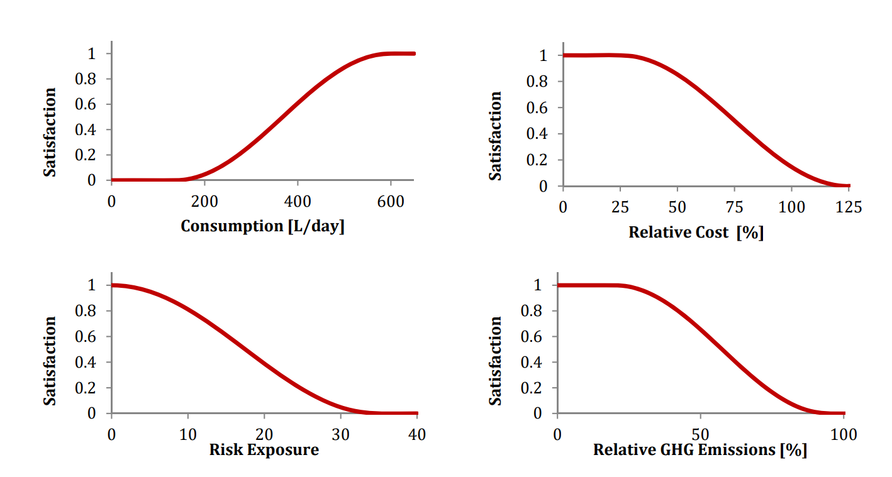
Appendix H: Satisfaction Curves (1)

Slide 28
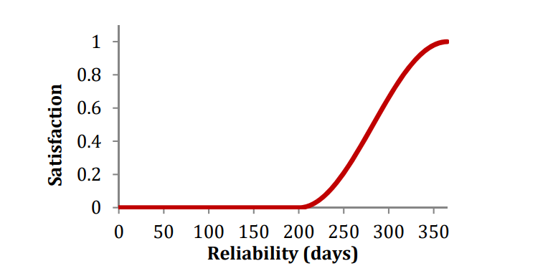
Appendix H: Satisfaction Curves (2)

Slide 29
Appendix I: Health and Environmental Risk
 |  | Irritation or Inconvenience | Minor injury- No medical Attention | Serious Injury - Medical Attention | Permanent injury or death
 |  | 1 | 2 | 3 | 4
Daily risk exposure | 4 | 4 | 8 | 12 | 16
Weekly risk exposure | 3 | 3 | 6 | 9 | 12
Monthly Risk exposure | 2 | 2 | 4 | 6 | 8
Yearly risk exposure | 1 | 1 | 2 | 3 | 4
 |  | Begin Contamination | Trace Contamination | Long-term Environmental Damage | Widespread irreversible damage
 |  | 1 | 2 | 3 | 4
Daily risk exposure | 4 | 4 | 8 | 12 | 16
Weekly risk exposure | 3 | 3 | 6 | 9 | 12
Monthly Risk exposure | 2 | 2 | 4 | 6 | 8
Yearly risk exposure | 1 | 1 | 2 | 3 | 4

